Slide 1

Advanced Programming with Python
Group 2: Public Governmental Service Information Management System

Slide 2
Members
Trịnh Quốc Hiếu BI10-060
Nguyễn Hoàng Sơn BI10-155
Phạm Đức Thắng BI10-159
Đỗ Thành Đạt BI10-026
Nguyễn Huy Hùng BI10-071

Slide 3
Table of content
Introduction
Structure
Demo

Slide 4
1. Introduction
a. Project content
Topic 9: Public Governmental Service Information Management System (e.g. birth/death declaration, marriage. . .)
b. Purpose
Use the Public Governmental Service Information Management System helps reduce time, costs, helps the government store and manage user information easier.

Slide 5
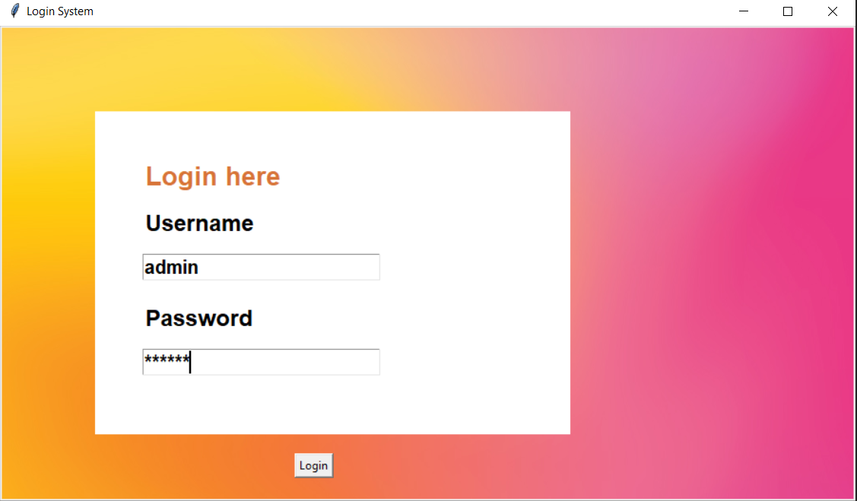
1. Introduction
We have 1 account “admin” to manage the project, we have to log in to use the project:

Slide 6
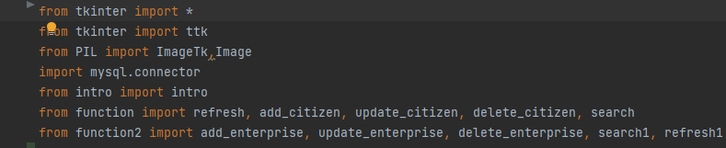
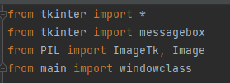
2. Structure
a. Modules and Packages
In main.py
In login.py

Slide 7
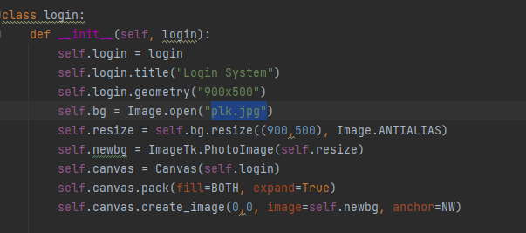
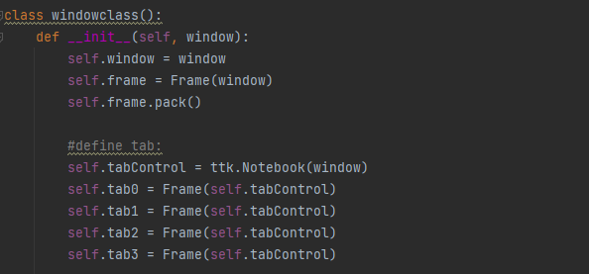
2.Structure
b. Class and Methods
We have two clases: windowclass() and login

Slide 8
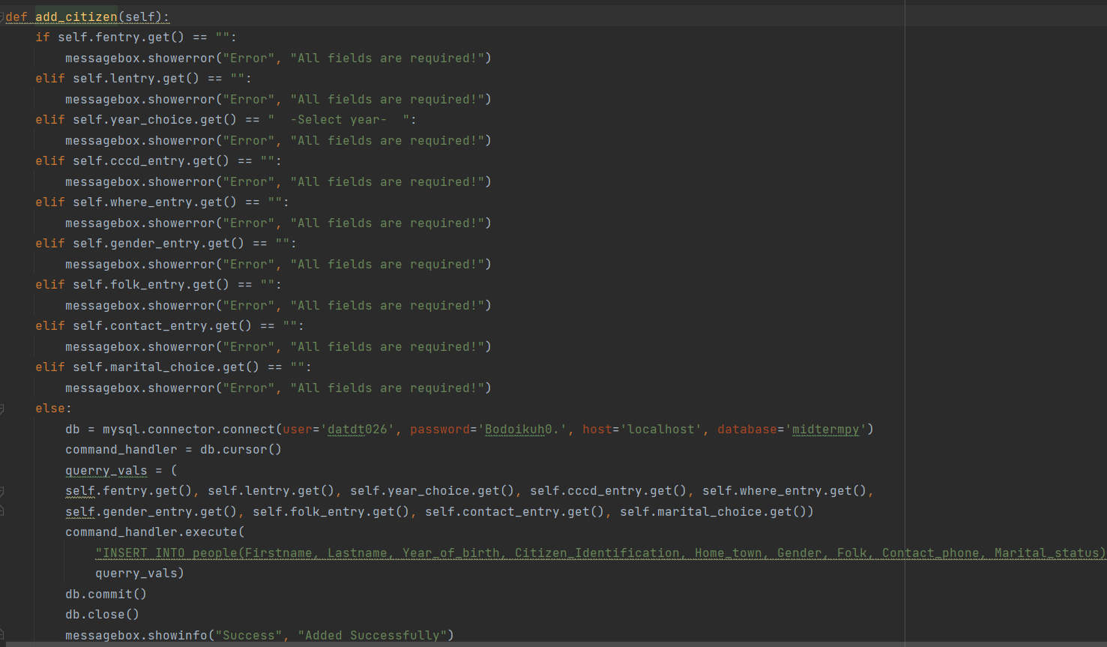
2.Structure
b. Class and Methods
Add

Slide 9
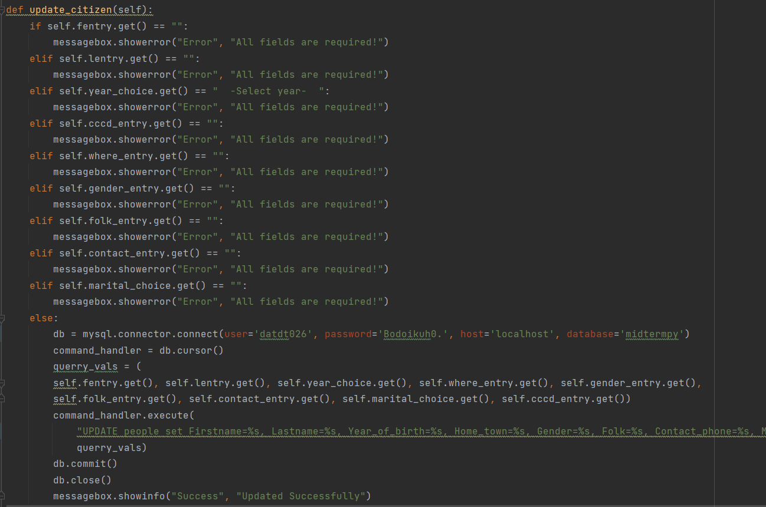
2.Structure
b. Class and Methods
Update

Slide 10
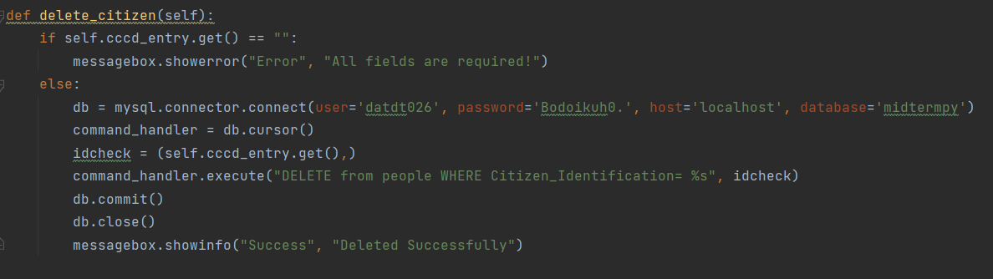
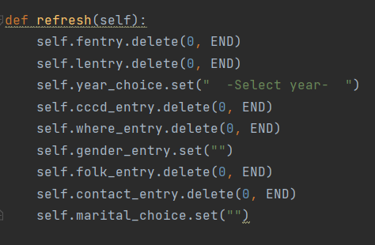
2.Structure
b. Class and Methods
Delete: delete one user’s data
Refresh : refresh all the fields to blank

Slide 11
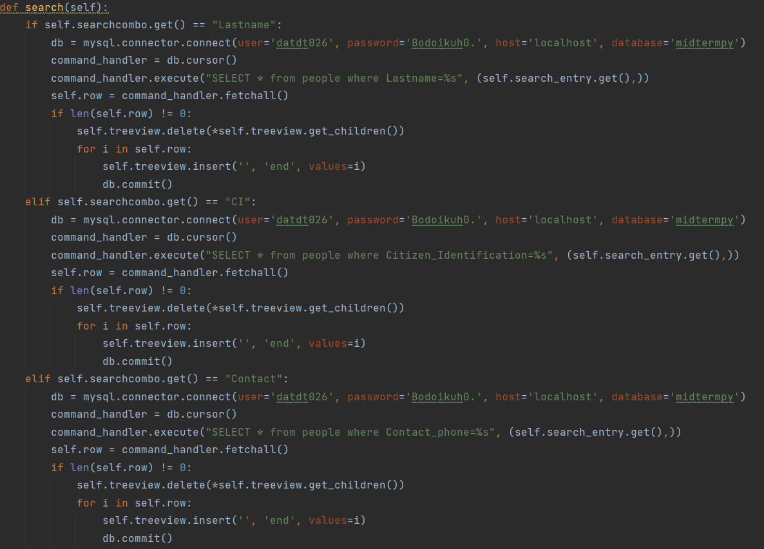
2.Structure
b. Class and Methods
In searching data

Slide 12
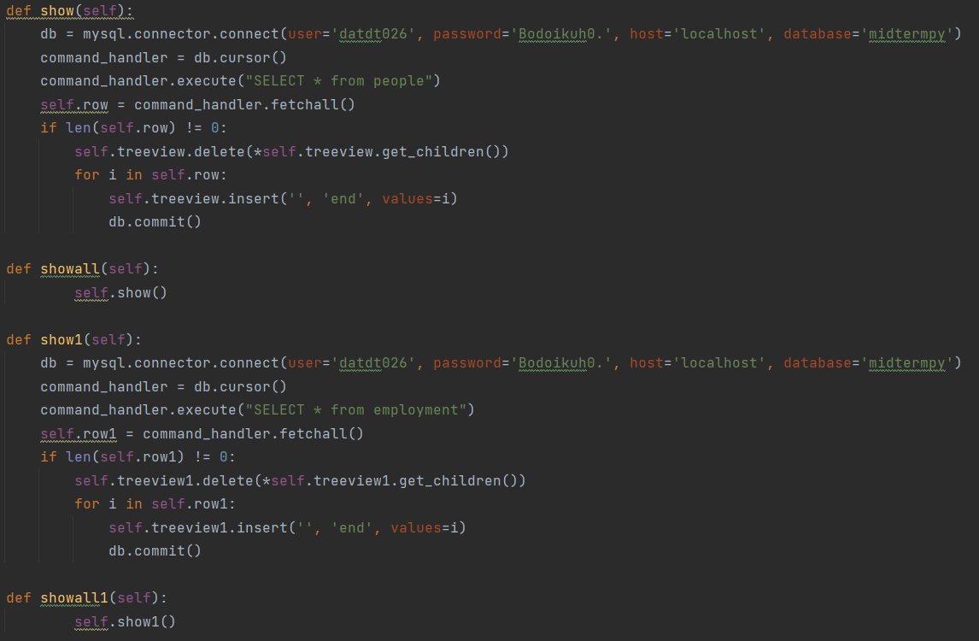
2.Structure
b. Class and Methods
List

Slide 13
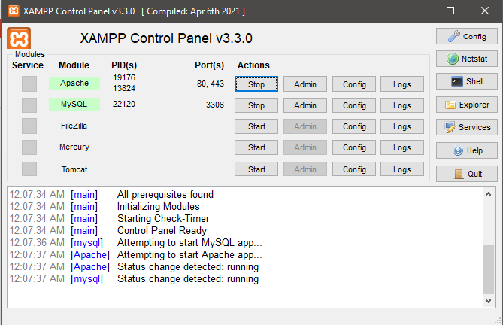
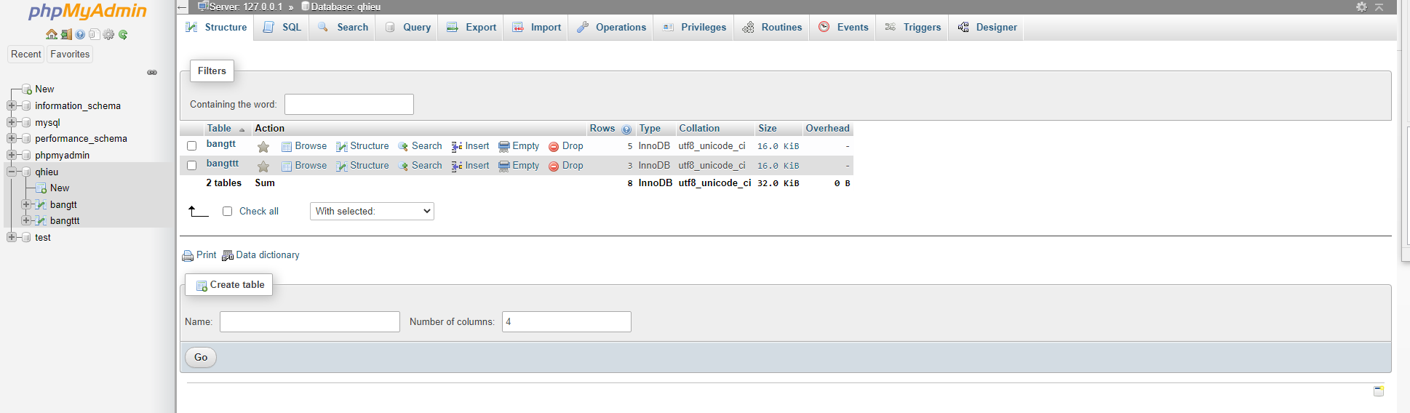
2.Structure
c. Database Diagram
XAMPP Control Panel
DATABASE

Slide 14
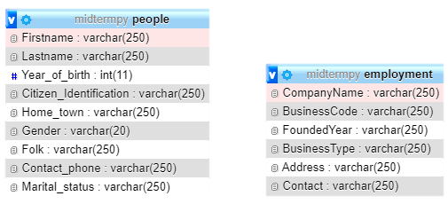
2.Structure
c. Database Diagram
Diagram

Slide 15
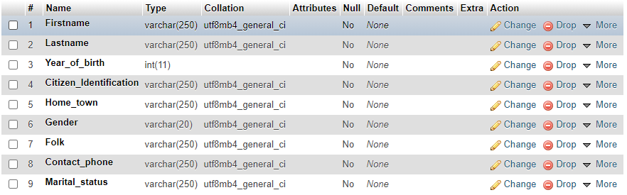
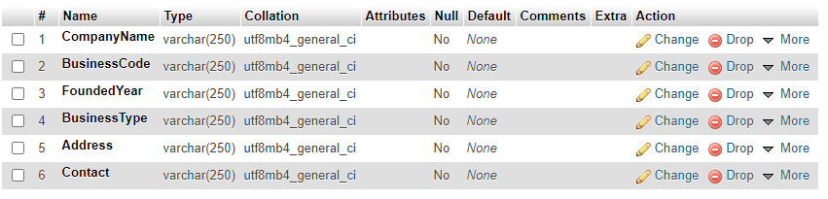
2.Structure
c. Database Diagram
People
Employment

Slide 16
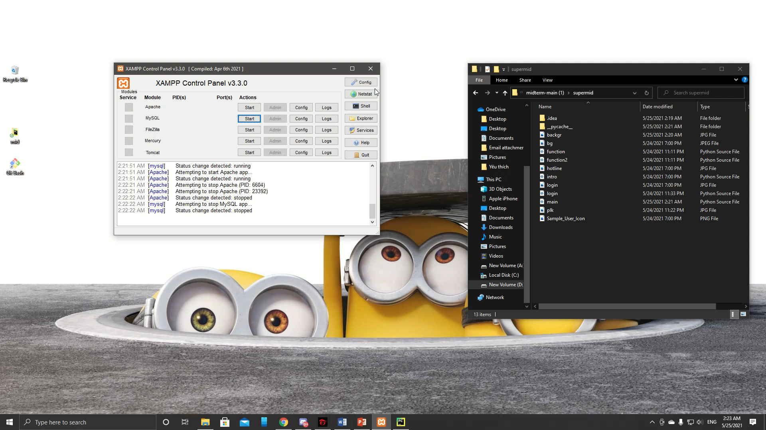
3. Demo

Slide 17


